Slide 1
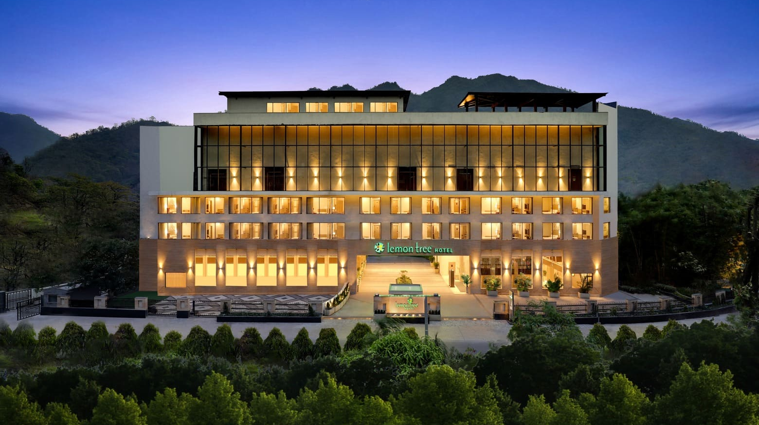

Hospitality Analysis
Codebasics resume challenge #1
Presented by: Dinesh Kumar S
Notes:
Hi everyone, I’m Dinesh, an aspiring data analyst. First, I’d like to thank Codebasics for creating this Resume Challenge. It gave me a valuable opportunity to work in hospitality domain and learn more about the industry. During this project, I learned about some key hotel metrics like ADR, RevPAR, DSRN, Occupancy Rate, and Realization Rate Now, let’s move on to the agenda of this presentation

Slide 2

AGENDA
COMAPANY OVERVIEW
PROBLEM STATEMENT
INSIGHTS
RECOMMENDATIONS
Notes:
First, we will look at the Company Overview, where I will explain the company’s background and the context of the data we’re analyzing.
Next, we will move on to the Problem Statement, where I will discuss the business problems the company is facing.
Finally, we’ll go through the Key Insights, followed by some Recommendations on how the company can regain its market share.

Slide 3
Company Overview
AtliQ Grands is a leading five-star hotel chain operating across major Indian cities such as Delhi, Mumbai, Bangalore, and Hyderabad. With over 20 years in the hospitality industry, AtliQ Grands specializes in two distinct hotel segments: business hotels, designed for corporate travelers, and luxury hotels, offering premium experiences for leisure guests. Each property features a variety of room classes
Elite
Standard
Premium
Presidential
tailored to meet the specific needs of its diverse clientele.
Notes:
So, AtliQ Grands is a well-known five-star hotel chain with properties in big cities like Delhi, Mumbai, Bangalore, and Hyderabad. They've been in the hospitality business for over 20 years.
They mainly run two types of hotels — business hotels for corporate travelers and luxury ones for people looking to relax and enjoy.
Each hotel has different room types like Elite, Standard, Premium, and Presidential to match different guest needs and budgets.

Slide 4
PROBLEM STATEMENT
AtliQ Grands, with over two decades of experience in the hospitality industry, is now facing significant challenges. Due to strategic moves from other competitors and ineffective decision-making in management, AtliQ Grands is losing its market share and revenue in the luxury/business hotels category. As a strategic move, the Managing Director of AtliQ Grands wanted to incorporate “Business and Data Intelligence” to regain their market share and revenue. However, they do not have an in-house data analytics team to provide them with these insights. Their revenue management team has decided to hire a third-party service provider to extract valuable insights from their historical data.
Notes:
Lately, AtliQ Grands has been facing a drop in revenue and market share.
They’re looking to understand why this is happening and what steps they can take to improve.
In this project, my aim is to analyze their data, find the root causes, and suggest possible solutions.

Slide 5
INSIGHTS
Week 27 recorded the lowest revenue at ₹42.93 million. In contrast, Weeks 19, 20, 22, 24, 25, 28, and 29 each generated high revenue, approximately ₹139 million.
Elite room type contributed the highest revenue at ₹553.74 million (32.81%), whereas the Standard room type contributed the lowest at ₹305.64 million (18.11%) of the total revenue.
Weekdays generated significantly more revenue (₹1164 million) compared to weekends (₹524 million).
Atliq Exotica led in revenue with ₹316 million, followed by Atliq Palace at ₹300 million, while Atliq Seasons contributed the lowest at ₹65 million
Others (unknown platforms) were the top contributor with ₹690 million, followed by MakeYourTrip with ₹337 million, while direct offline bookings accounted for the lowest at ₹85 million.
Out of the total revenue generated of ₹1983 million, only ₹1687.8 million was realized, resulting in a loss of ₹295.2 million due to cancellations.
Mumbai generated the highest city-wise revenue at ₹660.64 million, while Delhi contributed the lowest at ₹290.92 million.
Notes:
Week 27 had the lowest revenue at around ₹42.93 million, while weeks like 19, 20, 22, and a few others did really well, with revenue close to ₹139 million each.
Among room types, Elite rooms brought in the most revenue — over ₹553 million — and Standard rooms brought in the least.
Weekdays performed way better than weekends, generating more than double the revenue.
Looking at hotel-wise performance, AtliQ Exotica earned the highest revenue, while AtliQ Seasons earned the least. In revenue by bookings most revenue came from unknown sources labeled as "Others", followed by MakeYourTrip.the lowest revenue came from Offline direct bookings
Out of ₹1983 million total revenue, only ₹1687.8 million was actually realized — the rest was lost due to cancellations.
Mumbai was the top-earning city, and Delhi was the lowest earning city

Slide 6
INSIGHTS
Luxury hotels generated the highest revenue at ₹1040.03 million, accounting for 62% of the total, while business hotels contributed ₹647.73 million, making up 38%.
Mumbai recorded the highest revenue in the luxury category with ₹408.21 million.
Occupancy was higher on weekends at 62.64% compared to 55.85% on weekdays.
Weekdays see a no-show rate of 5.08%, while weekends fare slightly better with a 4.89% no-show rate.
Atliq Seasons had the lowest average rating (2.3) and occupancy (44.57%), while Atliq Blu had the highest rating (4.0) and occupancy (61.92%), indicating a positive correlation between rating and occupancy.
Others (unknown channels) accounted for 40.9% of bookings, followed by MakeYourTrip at 20%, with direct offline having the lowest share at 5%.
Elite rooms led with the highest booking share at 36.8%, whereas Presidential rooms had the lowest at 11.9%.
Atliq Exotica, Mumbai (Property ID: 16559) and Atliq Bay, Hyderabad (Property ID: 18562) recorded the highest DBRN of 80, while Atliq Grands, Delhi (Property ID: 16558) had the lowest at 34.
Notes:
Luxury hotels made more money than business ones — about 62% of the total revenue. Mumbai topped the list in the luxury category.
Occupancy was better on weekends than weekdays. No-show rates were a bit lower on weekends too.
AtliQ Blu had the best rating and occupancy, while AtliQ Seasons had the lowest, which shows ratings do affect bookings.
Most bookings came from unknown sources, followed by MakeYourTrip. And Offline direct bookings were the lowest. Elite rooms were booked the most, and Presidential rooms the least.
Also, , AtliQ Exotica in Mumbai and AtliQ Bay in Hyderabad had the highest DBRN at 80, while AtliQ Grands in Delhi had the lowest at 34.

Slide 7
RECOMMENDATION
Focus Marketing On High-Performing Weeks Promote and replicate the strategies used in Weeks 19, 20, 22, 24, 25, 28, and 29 across other low-performing weeks, especially Week 27 which had the lowest revenue.
Maximize Weekday Potential Weekdays bring in significantly more revenue than weekends. Implement targeted weekday packages for business travelers and offer early check-in / late check-out for extended stays.
Revive Underperforming Properties like Atliq Seasons With both the lowest revenue and lowest average rating, Atliq Seasons needs immediate attention—focus on service improvement, refurbishment, and online reputation management.
Leverage High-Growth Properties Atliq Exotica and Atliq Palace are revenue leaders. Analyze what’s working well there—whether it's pricing, staff, amenities, or location—and replicate those practices across lower-performing hotels.
Notes:
These are some of the recommendations to overcome the problem and regain the market share Weeks like 19, 20, and 25 made high revenue. We should follow the same strategy in low weeks like Week 27.
Next, weekdays perform better than weekends. We can bring more weekday bookings with special deals for business guests.
Now, Atliq Seasons needs attention. It had low revenue and low rating. We should improve service and fix any issues.
Atliq Exotica and Palace are doing great learn from these top hotels and find what works for them and apply it to other hotels.

Slide 8
Improve Booking Platform Mix Unknown/Other platforms contribute 40.9% of bookings and the most revenue. Explore these sources to gain control and insights. Simultaneously, work to boost direct offline bookings through exclusive deals, loyalty programs, and seamless booking interfaces.
Address Revenue Leakage With ₹295.2 million in revenue lost, investigate causes like last-minute cancellations, Introduce strict cancellation policies.
Optimize Pricing Based on City Performance Mumbai contributes the most to revenue. consider dynamic pricing models for Mumbai and promotional pricing for cities like Delhi to increase their competitiveness.
Prioritize Luxury Segment The luxury category dominates both in revenue (₹1040.03M) and bookings (62.17%). Continue investing in this segment with premium experiences and high-end partnerships.
RECOMMENDATION
Notes:
Let’s look at booking platforms. Most bookings come from unknown sources. We should explore them and try to increase direct offline bookings with better offers and loyalty rewards.
Next, we lost ₹295 million in revenue. That’s a big gap. We should reduce cancellations and no-shows by using stricter policies and reminders.
Now, talking about cities— Mumbai gives the highest revenue. We can try dynamic pricing here and offer discounts in cities like Delhi to boost bookings. Luxury hotels bring in the most money and bookings. We should give more focus here and offer premium services.
Business hotels still have a good share. We can grow this by offering special deals for corporate guests.

Slide 9
RECOMMENDATION
Leverage Customer Ratings for Revenue Growth High occupancy correlates with higher ratings. Focus on improving service quality at low-rated properties and actively collect feedback to push ratings above 4.0.
Platform Partnerships Strengthen relationships with top performers like MakeYourTrip. Negotiate better visibility or lower commission rates. Simultaneously, invest in improving the direct booking experience to reduce dependency on third-party platforms.
Rebalance Room Class Inventory With Elite rooms booking the most and Presidential rooms the least, evaluate whether some Presidential inventory can be reclassified or re-priced to drive better utilization.
Monitor Property-Level DBRN High-performing properties in terms of Daily Booked Room Nights (DBRN) should be used as benchmarks. Offer DBRN-based incentives to other properties to motivate performance.
Notes:
Properties with high ratings also have more bookings. We should focus on improving service and collecting reviews—aim for 4 stars and above.
MakeYourTrip is a strong partner. Let’s build that relationship and also improve our direct booking options to save on commissions.
Elite rooms are the most booked, but Presidential rooms are the least. We could reprice or reclassify some rooms to boost their use.
Some hotels have more daily bookings than others. We can use those as benchmarks and Offer DBRN-based incentives to other properties to motivate performance.

Slide 10
Thankyou!
Dinesh Kumar S dinesh.works@gmail.com My Portfolio GitHub
Notes:
That’s the end of my hospitality analysis. Thank you so much for watching!
This project helped me build domain knowledge in the hotel industry and sharpen my storytelling skills check out my project portfolio and GitHub for more details on my work.

